Slide 1


VPK Summer Bridge #onebrevard
A free, district-operated program designed to support eligible VPK students who need additional readiness skills prior to entering kindergarten.
Notes:
I want to start today by clarifying what Summer Bridge is and what it is not.
Summer Bridge is NOT, Summer VPK. Summer VPK is the program designed for students who did not use a VPK certificate during the school year. In summer VPK, students can use their VPK certificate to receive 300 hours of instruction before they enter Kindergarten.
Summer Bridge students are different. These students must be VPK completers, meaning they have already used their VPK certificates and they are in need of additional support to be ready for Kindergarten. Brevard Public schools operates this Summer Bridge program.

Slide 2


“…launched with the unequivocal goal of every child being able to read at or above grade level.”
Notes:
Let’s talk a little bit about how Summer Bridge came into existence.
In 2001, Governor Jeb Bush signed Executive Order 01-260, designating Just Read, Florida! as a reading initiative establishing reading as a core value in the state.
So last year, Just Read, Florida, created the Summer Bridge program for school districts to provide interventions for students who were demonstrating deficiencies in their early literacy skills.

Slide 3

How Summer Bridge will impact our community?
#onebrevard
For children who enter kindergarten behind, roughly 75% will never catch up to their classmates.
Notes:
The students served will be our most at risk so we will be providing 25 days (100 hours) of intensive interventions with a focus on early literacy skills –all based on the Science of Reading.
Our Summer Bridge programs aims to fill some of those early literacy gaps for Brevard’s future kindergartens.

Slide 4
One teacher One paraprofessional One hundred hours of instruction
Eligible Students
Students who have scored below the 25th percentile on the FAST PM 3 or have a non-participation status due to assessment inappropriate, non- English speaker or failed practice attempts.
Notes:
Legislatively, we are mandated to serve all students that score below the 25th percentile

Slide 5

Intensive Interventions
*Baseline & Summative assessment
*Benchmark curriculum themes to build content knowledge and vocabulary *Scholastic Alphatales *Readers Theater *Phonological awareness instruction and games *Multi-sensory instruction to promote early literacy skills
Notes:
Administer a Baseline and summative assessment to see progress.
Build knowledge and vocabulary using the Benchmark themes. Without background knowledge, language comprehension suffers so we need to be building knowledge daily!
Alphatales books will be used to share singsong alliterative text which is so important in helping our students to hear the sounds of our language.
Readers Theater will be used to enhance oral language development. On the last day of the program, parents will be invited to watch one of the five performances that their child will have learned and practiced during the program.
We all know the importance of PA to growing readers. Students will be stomping out the sounds, clapping to words in text and dancing to catchy songs

Slide 6


Notes:
Describes the district’s plan for Summer Bridge

Slide 7
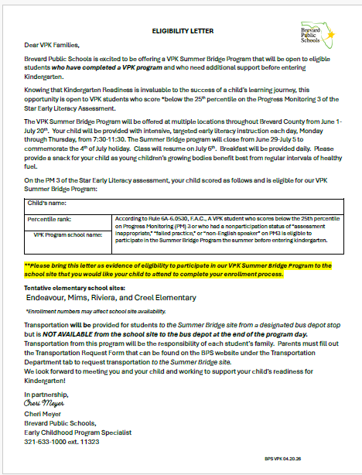

Send home the Letter of Eligibility and the Summer Bridge Flyer for any eligible students
CC

Slide 8


Parents need to visit the school they are interested in attending to drop off their Letter of Eligibility.
School clerk will help your families to create a FOCUS account and will enroll their child in the Summer Bridge Program.

Slide 9


Parents will need to visit the BPS Website to request Transportation to their Summer Bridge site.

Slide 10

Together, we can create a promising future for all of Brevard’s children!
Notes:
Summer Bridge can be a golden opportunity for any students that are already showing signs of needing interventions in early literacy. Please ensure that all of your families are informed of this opportunity. This experience can be potentially life changing. Think of that statistic of never catching up to their classmates.
Questions?

